Slide 1
CS 110
Computer Architecture
Lecture 18:
Amdahl’s Law, Data-level Parallelism
Instructor:
Sören Schwertfeger
http://shtech.org/courses/ca/
School of Information Science and Technology SIST
ShanghaiTech University
Slides based on UC Berkley's CS61C

Slide 2





New-School Machine Structures
(It’s a bit more complicated!)
Software Hardware
Parallel Requests
  Assigned to computer
  e.g., Search “Katz”
Parallel Threads
  Assigned to core
  e.g., Lookup, Ads
Parallel Instructions
  >1 instruction @ one time
  e.g., 5 pipelined instructions
Parallel Data
  >1 data item @ one time
  e.g., Add of 4 pairs of words
Hardware descriptions
  All gates @ one time
Programming Languages
Warehouse Scale Computer
Smart
Phone
Harness
Parallelism &
Achieve High
Performance
Computer
Core
…
Core
Memory (Cache)
Input/Output
Core
Today’s
Lecture
Instruction Unit(s)
Functional
Unit(s)
A₀+B₀
A₁+B₁
A₂+B₂
A₃+B₃
Cache Memory
Logic Gates

Slide 3
Using Parallelism for Performance
Two basic ways:
  Multiprogramming
    run multiple independent programs in parallel
    “Easy”
  Parallel computing
    run one program faster
    “Hard”
We’ll focus on parallel computing for next few lectures

Slide 4
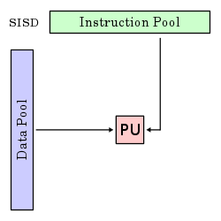
Single-Instruction/Single-Data Stream
(SISD)
Sequential computer that exploits no parallelism in either the instruction or data streams. Examples of SISD architecture are traditional uniprocessor machines
Processing Unit

Slide 5
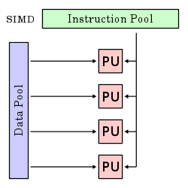
Single-Instruction/Multiple-Data Stream
(SIMD or “sim-dee”)
SIMD computer exploits multiple data streams against a single instruction stream to operations that may be naturally parallelized, e.g., Intel SIMD instruction extensions or NVIDIA Graphics Processing Unit (GPU)

Slide 6
Multiple-Instruction/Multiple-Data Streams
(MIMD or “mim-dee”)
Multiple autonomous processors simultaneously executing different instructions on different data.
  MIMD architectures include multicore and Warehouse-Scale Computers
Instruction Pool
PU
PU
Data Pool
PU
PU

Slide 7
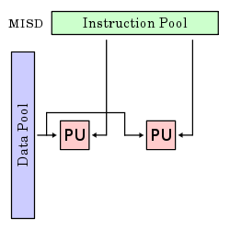
Multiple-Instruction/Single-Data Stream
(MISD)
Multiple-Instruction, Single-Data stream computer that exploits multiple instruction streams against a single data stream.
  Rare, mainly of historical interest only

Slide 8
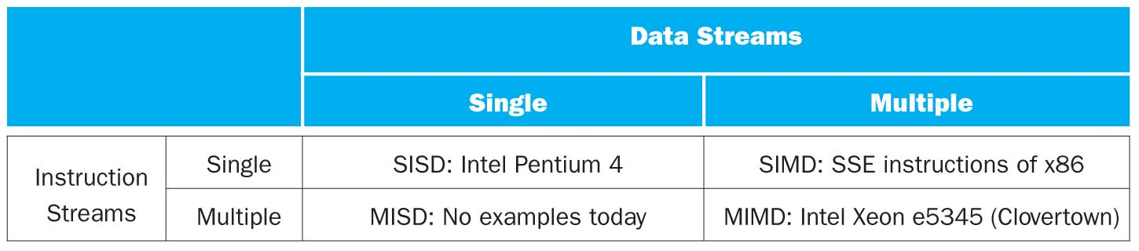

Flynn* Taxonomy, 1966
In 2013, SIMD and MIMD most common parallelism in architectures – usually both in same system!
Most common parallel processing programming style: Single Program Multiple Data (“SPMD”)
  Single program that runs on all processors of a MIMD
  Cross-processor execution coordination using synchronization primitives
SIMD (aka hw-level data parallelism): specialized function units, for handling lock-step calculations involving arrays
  Scientific computing, signal processing, multimedia (audio/video processing)
*Prof. Michael Flynn, Stanford

Slide 9
Big Idea: Amdahl’s (Heartbreaking) Law
Speedup due to enhancement E is
Exec time w/o E
Speedup w/ E = ----------------------
Exec time w/ E
Suppose that enhancement E accelerates a fraction F (F <1) of the task by a factor S (S>1) and the remainder of the task is unaffected
Execution Time w/o E x [ (1-F) + F/S]
Execution Time w/ E =
1 / [ (1-F) + F/S ]
Speedup w/ E =

Slide 10
Big Idea: Amdahl’s Law
Speedup = 1
(1 - F) + F
Non-speed-up part
S
Speed-up part
Example: the execution time of half of the program can be accelerated by a factor of 2.
What is the program speed-up overall?
1
1
=
=
1.33
0.5 + 0.5
0.5 + 0.25
2

Slide 11
Example #1: Amdahl’s Law
Speedup w/ E = 1 / [ (1-F) + F/S ]
Consider an enhancement which runs 20 times faster but which is only usable 25% of the time
Speedup w/ E = 1/(.75 + .25/20) = 1.31
What if its usable only 15% of the time?
Speedup w/ E = 1/(.85 + .15/20) = 1.17
Amdahl’s Law tells us that to achieve linear speedup with 100 processors, none of the original computation can be scalar!
To get a speedup of 90 from 100 processors, the percentage of the original program that could be scalar would have to be 0.1% or less
Speedup w/ E = 1/(.001 + .999/100) = 90.99

Slide 12
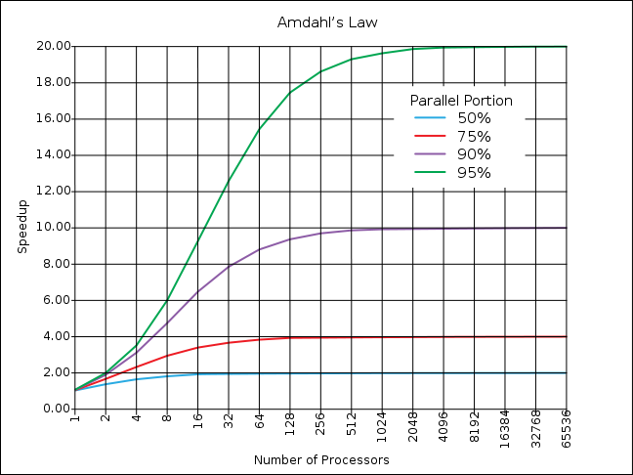
If the portion of
the program that
can be parallelized
is small, then the
speedup is limited
The non-parallel
portion limits
the performance

Slide 13
Strong and Weak Scaling
To get good speedup on a parallel processor while keeping the problem size fixed is harder than getting good speedup by increasing the size of the problem.
  Strong scaling: when speedup can be achieved on a parallel processor without increasing the size of the problem
  Weak scaling: when speedup is achieved on a parallel processor by increasing the size of the problem proportionally to the increase in the number of processors
Load balancing is another important factor: every processor doing same amount of work
  Just one unit with twice the load of others cuts speedup almost in half
Notes:
Add load balancing example here – page 638

Slide 14
Question
Suppose a program spends 80% of its time in a square root routine. How much must you speedup square root to make the program run 5 times faster?
A: 5
B: 16
C: 20
D: 100
E: None of the above
Speedup w/ E = 1 / [ (1-F) + F/S ]
Notes:
Answer: E
Need infinitely fast to get to 5X
5 = 2.8
10 = 3.6
20 = 4.2
100 = 4.8

Slide 15
SIMD Architectures
Data parallelism: executing same operation on multiple data streams
Example to provide context:
  Multiplying a coefficient vector by a data vector
  (e.g., in filtering)
y[i] := c[i]× x[i], 0 ≤ i < n
Sources of performance improvement:
  One instruction is fetched & decoded for entire operation
  Multiplications are known to be independent
  Pipelining/concurrency in memory access as well

Slide 16
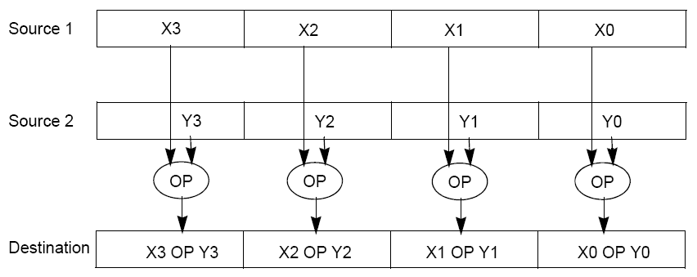
Intel “Advanced Digital Media Boost”
To improve performance, Intel’s SIMD instructions
  Fetch one instruction, do the work of multiple instructions
Notes:
Vector of numbers => vector operation

Slide 17
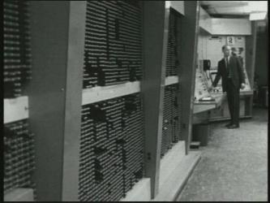
First SIMD Extensions:
MIT Lincoln Labs TX-2, 1957

Slide 18
Admin
Project Checkup:
  2 groups from lab 1 missing: today after lecture!
  Lab 2 and 3: everybody needs to attend
Project 2.x:
  Use git to share your work and collaborate
  New rule enforced:
    Every group member needs to have at least 2 commits and at least 25% of the # commits from his own PC.
    Penalty for violation: 10% off project score for violator!
    Will be posted also on piazza

Slide 19
Intel SIMD Extensions
MMX 64-bit registers, reusing floating-point registers [1992]
SSE2/3/4, new 128-bit registers [1999]
AVX, new 256-bit registers [2011]
  Space for expansion to 1024-bit registers
Notes:
Mmx 32 bit integer reg. FPU: 2 32 bit integers or 4 16bit integers ….
SSE Streaming SIMD Extensions
Advanced Vector Extensions

Slide 20
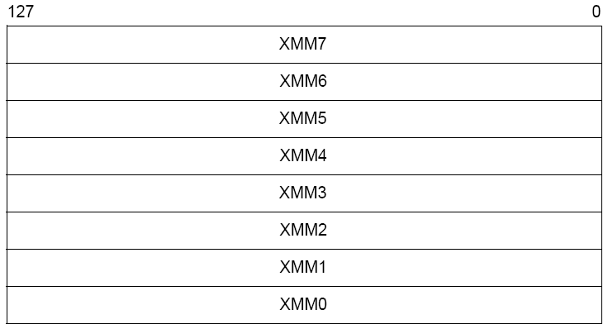
XMM Registers
Architecture extended with eight 128-bit data registers: XMM registers
  x86 64-bit address architecture adds 8 additional registers (XMM8 – XMM15)
Notes:
SSE: XMM registers

Slide 21
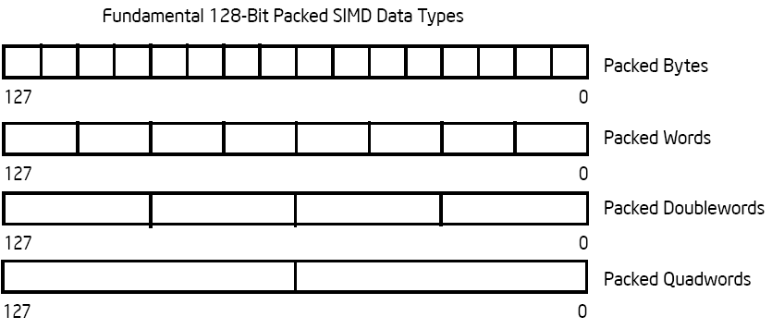
Intel Architecture SSE2+
128-Bit SIMD Data Types
Note: in Intel Architecture (unlike MIPS) a word is 16 bits
  Single-precision FP: Double word (32 bits)
  Double-precision FP: Quad word (64 bits)
122 121
96 95
80 79
64 63
48 47
32 31
16 15
16 / 128 bits
122 121
96 95
80 79
64 63
48 47
32 31
16 15
8 / 128 bits
96 95
64 63
32 31
4 / 128 bits
64 63
2 / 128 bits

Slide 22
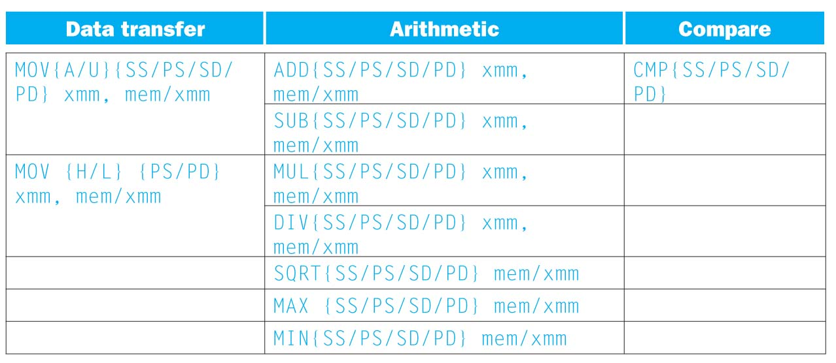
SSE/SSE2 Floating Point Instructions
Move does both load and store
xmm: one operand is a 128-bit SSE2 register
mem/xmm: other operand is in memory or an SSE2 register
{SS} Scalar Single precision FP: one 32-bit operand in a 128-bit register
{PS} Packed Single precision FP: four 32-bit operands in a 128-bit register
{SD} Scalar Double precision FP: one 64-bit operand in a 128-bit register
{PD} Packed Double precision FP, or two 64-bit operands in a 128-bit register
{A} 128-bit operand is aligned in memory
{U} means the 128-bit operand is unaligned in memory
{H} means move the high half of the 128-bit operand
{L} means move the low half of the 128-bit operand

Slide 23
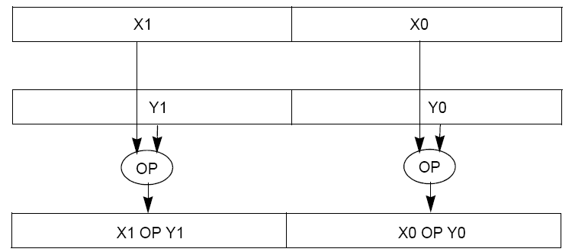
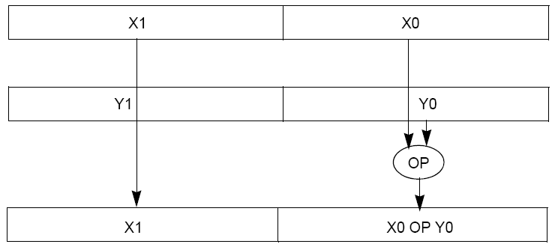
Packed and Scalar Double-Precision Floating-Point Operations
Packed
Scalar
Notes:
Scalar: the same as normal FP but using the faster hardware…

Slide 24
Example: SIMD Array Processing
for each f in array
f = sqrt(f)
for each f in array
{
load f to the floating-point register
calculate the square root
write the result from the register to memory
}
for each 4 members in array
{
load 4 members to the SSE register
calculate 4 square roots in one operation
store the 4 results from the register to memory
}
SIMD style

Slide 25
Data-Level Parallelism and SIMD
SIMD wants adjacent values in memory that can be operated in parallel
Usually specified in programs as loops
for(i=1000; i>0; i=i-1)
x[i] = x[i] + s;
How can reveal more data-level parallelism than available in a single iteration of a loop?
Unroll loop and adjust iteration rate

Slide 26
Looping in MIPS
Assumptions:
$t1 is initially the address of the element in the array with the highest address
$f0 contains the scalar value s
8($t2) is the address of the last element to operate on
CODE:
Loop: 1. l.d $f2,0($t1) ; $f2=array element
2. add.d $f10,$f2,$f0 ; add s to $f2
3. s.d $f10,0($t1) ; store result
4. addiu $t1,$t1,#-8 ; decrement pointer 8 byte
5. bne $t1,$t2,Loop ; repeat loop if $t1 != $t2

Slide 27
Loop Unrolled
Loop: l.d $f2,0($t1)
add.d $f10,$f2,$f0
s.d $f10,0($t1)
l.d $f4,-8($t1)
add.d $f12,$f4,$f0
s.d $f12,-8($t1)
l.d $f6,-16($t1)
add.d $f14,$f6,$f0
s.d $f14,-16($t1)
l.d $f8,-24($t1)
add.d $f16,$f8,$f0
s.d $f16,-24($t1)
addiu $t1,$t1,#-32
bne $t1,$t2,Loop
NOTE:
Only 1 Loop Overhead every 4 iterations
This unrolling works if
loop_limit(mod 4) = 0
3. Using different registers for each iteration eliminates data hazards in pipeline

Slide 28
Loop Unrolled Scheduled
Loop:l.d $f2,0($t1)
l.d $f4,-8($t1)
l.d $f6,-16($t1)
l.d $f8,-24($t1)
add.d $f10,$f2,$f0
add.d $f12,$f4,$f0
add.d $f14,$f6,$f0
add.d $f16,$f8,$f0
s.d $f10,0($t1)
s.d $f12,-8($t1)
s.d $f14,-16($t1)
s.d $f16,-24($t1)
addiu $t1,$t1,#-32
bne $t1,$t2,Loop
4 Loads side-by-side: Could replace with 4-wide SIMD Load
4 Adds side-by-side: Could replace with 4-wide SIMD Add
4 Stores side-by-side: Could replace with 4-wide SIMD Store
Notes:
Even scalar code is faster this way…. :
Spread apart instructions that depend on each other!

Slide 29
Loop Unrolling in C
Instead of compiler doing loop unrolling, could do it yourself in C
for(i=1000; i>0; i=i-1)
x[i] = x[i] + s;
Could be rewritten
for(i=1000; i>0; i=i-4) {
x[i] = x[i] + s;
x[i-1] = x[i-1] + s;
x[i-2] = x[i-2] + s;
x[i-3] = x[i-3] + s;
}
What is downside of doing it in C?
Notes:
In C:
no scheduling
Portability

Slide 30
Generalizing Loop Unrolling
A loop of n iterations
k copies of the body of the loop
Assuming (n mod k) ≠ 0
Then we will run the loop with 1 copy of the body (n mod k) times and with k copies of the body floor(n/k) times

Slide 31
Example: Add Two Single-Precision
Floating-Point Vectors
Computation to be performed:
vec_res.x = v1.x + v2.x;
vec_res.y = v1.y + v2.y;
vec_res.z = v1.z + v2.z;
vec_res.w = v1.w + v2.w;
SSE Instruction Sequence:
(Note: Destination on the right in x86 assembly)
movaps address-of-v1, %xmm0
// v1.w | v1.z | v1.y | v1.x -> xmm0
addps address-of-v2, %xmm0
// v1.w+v2.w | v1.z+v2.z | v1.y+v2.y | v1.x+v2.x -> xmm0
movaps %xmm0, address-of-vec_res
mov a ps : move from mem to XMM register,
mem ory aligned, packed single precision
add ps : add from mem to XMM register,
packed single precision
mov a ps : move from XMM register to mem,
memory aligned, packed single precision
Notes:
movaps: move aligned packed single (single float) : aligned on 16 bytes (128bit) – x86 also has unaligned access (slower)…
addps: add packed single operant, source and destination

Slide 32
Intel SSE Intrinsics
Intrinsics are C functions and procedures for inserting assembly language into C code, including SSE instructions
  With intrinsics, can program using these instructions indirectly
  One-to-one correspondence between SSE instructions and intrinsics

Slide 33
Example SSE Intrinsics
Intrinsics:
Corresponding SSE instructions:
Vector data type:
_m128d
Load and store operations:
_mm_load_pd MOVAPD/aligned, packed double
_mm_store_pd MOVAPD/aligned, packed double
_mm_loadu_pd MOVUPD/unaligned, packed double
_mm_storeu_pd MOVUPD/unaligned, packed double
Load and broadcast across vector
_mm_load1_pd MOVSD + shuffling/duplicating
Arithmetic:
_mm_add_pd ADDPD/add, packed double
_mm_mul_pd MULPD/multiple, packed double
Notes:
CS267 Lecture 2
33

Slide 34
Example: 2 x 2 Matrix Multiply
Definition of Matrix Multiply:
2
C_{i,j} = (A×B)_{i,j} = ∑ A_{i,k}× B_{k,j}
k = 1
A_{1,1}
A_{1,2}
B_{1,1}
B_{1,2}
C_{1,1}=A_{1,1}B_{1,1} + A_{1,2}B_{2,1}
C_{1,2}=A_{1,1}B_{1,2}+A_{1,2}B_{2,2}
x
=
A_{2,1}
A_{2,2}
B_{2,1}
B_{2,2}
C_{2,1}=A_{2,1}B_{1,1} + A_{2,2}B_{2,1}
C_{2,2}=A_{2,1}B_{1,2}+A_{2,2}B_{2,2}
1
0
1
3
C_{1,1}= 1*1 + 0*2 = 1
C_{1,2}= 1*3 + 0*4 = 3
x
=
0
1
2
4
C_{2,1}= 0*1 + 1*2 = 2
C_{2,2}= 0*3 + 1*4 = 4

Slide 35
Example: 2 x 2 Matrix Multiply
Using the XMM registers
  64-bit/double precision/two doubles per XMM reg
C₁
C_{1,1}
C_{2,1}
Stored in memory in Column order
C₂
C_{1,2}
C_{2,2}
A
A_{1,i}
A_{2,i}
B₁
B_{i,1}
B_{i,1}
C₁
C₂
B₂
B_{i,2}
B_{i,2}

Slide 36
Example: 2 x 2 Matrix Multiply
Initialization
I = 1
C₁
0
0
C₂
0
0
A
A_{1,1}
A_{2,1}
_mm_load_pd: Stored in memory in
Column order
B₁
B_{1,1}
B_{1,1}
_mm_load1_pd: SSE instruction that loads
a double word and stores it in the high and
low double words of the XMM register
B₂
B_{1,2}
B_{1,2}

Slide 37
Example: 2 x 2 Matrix Multiply
Initialization
I = 1
C₁
0
0
C₂
0
0
A
A_{1,1}
A_{2,1}
_mm_load_pd: Load 2 doubles into XMM reg, Stored in memory in Column order
B₁
B_{1,1}
B_{1,1}
_mm_load1_pd: SSE instruction that loads
a double word and stores it in the high and
low double words of the XMM register
(duplicates value in both halves of XMM)
B₂
B_{1,2}
B_{1,2}

Slide 38
Example: 2 x 2 Matrix Multiply
First iteration intermediate result
I = 1
C₁
0+A_{1,1}B_{1,1}
0+A_{2,1}B_{1,1}
c1 = _mm_add_pd(c1,_mm_mul_pd(a,b1));
c2 = _mm_add_pd(c2,_mm_mul_pd(a,b2));
SSE instructions first do parallel multiplies
and then parallel adds in XMM registers
C₂
0+A_{1,1}B_{1,2}
0+A_{2,1}B_{1,2}
A
A_{1,1}
A_{2,1}
_mm_load_pd: Stored in memory in
Column order
B₁
B_{1,1}
B_{1,1}
_mm_load1_pd: SSE instruction that loads
a double word and stores it in the high and
low double words of the XMM register
(duplicates value in both halves of XMM)
B₂
B_{1,2}
B_{1,2}

Slide 39
Example: 2 x 2 Matrix Multiply
First iteration intermediate result
I = 2
C₁
0+A_{1,1}B_{1,1}
0+A_{2,1}B_{1,1}
c1 = _mm_add_pd(c1,_mm_mul_pd(a,b1));
c2 = _mm_add_pd(c2,_mm_mul_pd(a,b2));
SSE instructions first do parallel multiplies
and then parallel adds in XMM registers
C₂
0+A_{1,1}B_{1,2}
0+A_{2,1}B_{1,2}
A
A_{1,2}
A_{2,2}
_mm_load_pd: Stored in memory in
Column order
B₁
B_{2,1}
B_{2,1}
_mm_load1_pd: SSE instruction that loads
a double word and stores it in the high and
low double words of the XMM register
(duplicates value in both halves of XMM)
B₂
B_{2,2}
B_{2,2}

Slide 40
Example: 2 x 2 Matrix Multiply
Second iteration intermediate result
I = 2
C_{1,1}
C_{2,1}
C₁
A_{1,1}B_{1,1}+A_{1,2}B_{2,1}
A_{2,1}B_{1,1}+A_{2,2}B_{2,1}
c1 = _mm_add_pd(c1,_mm_mul_pd(a,b1));
c2 = _mm_add_pd(c2,_mm_mul_pd(a,b2));
SSE instructions first do parallel multiplies
and then parallel adds in XMM registers
C₂
A_{1,1}B_{1,2}+A_{1,2}B_{2,2}
A_{2,1}B_{1,2}+A_{2,2}B_{2,2}
C_{1,2}
C_{2,2}
A
A_{1,2}
A_{2,2}
_mm_load_pd: Stored in memory in
Column order
B₁
B_{2,1}
B_{2,1}
_mm_load1_pd: SSE instruction that loads
a double word and stores it in the high and
low double words of the XMM register
(duplicates value in both halves of XMM)
B₂
B_{2,2}
B_{2,2}

Slide 41
Example: 2 x 2 Matrix Multiply
(Part 1 of 2)
#include <stdio.h>
// header file for SSE compiler intrinsics
#include <emmintrin.h>
// NOTE: vector registers will be represented in
// comments as v1 = [ a | b]
// where v1 is a variable of type __m128d and
// a, b are doubles
int main(void) {
// allocate A,B,C aligned on 16-byte boundaries
double A[4] __attribute__ ((aligned (16)));
double B[4] __attribute__ ((aligned (16)));
double C[4] __attribute__ ((aligned (16)));
int lda = 2;
int i = 0;
// declare several 128-bit vector variables
__m128d c1,c2,a,b1,b2;
// Initialize A, B, C for example
/* A = (note column order!)
1 0
0 1
*/
A[0] = 1.0; A[1] = 0.0; A[2] = 0.0; A[3] = 1.0;
/* B = (note column order!)
1 3
2 4
*/
B[0] = 1.0; B[1] = 2.0; B[2] = 3.0; B[3] = 4.0;
/* C = (note column order!)
0 0
0 0
*/
C[0] = 0.0; C[1] = 0.0; C[2] = 0.0; C[3] = 0.0;
Notes:
Emmintrin extended multimedia intrinsics

Slide 42
Example: 2 x 2 Matrix Multiply
(Part 2 of 2)
// used aligned loads to set
// c1 = [c_11 | c_21]
c1 = _mm_load_pd(C+0*lda);
// c2 = [c_12 | c_22]
c2 = _mm_load_pd(C+1*lda);
for (i = 0; i < 2; i++) {
/* a =
i = 0: [a_11 | a_21]
i = 1: [a_12 | a_22]
*/
a = _mm_load_pd(A+i*lda);
/* b1 =
i = 0: [b_11 | b_11]
i = 1: [b_21 | b_21]
*/
b1 = _mm_load1_pd(B+i+0*lda);
/* b2 =
i = 0: [b_12 | b_12]
i = 1: [b_22 | b_22]
*/
b2 = _mm_load1_pd(B+i+1*lda);
/* c1 =
i = 0: [c_11 + a_11*b_11 | c_21 + a_21*b_11]
i = 1: [c_11 + a_21*b_21 | c_21 + a_22*b_21]
*/
c1 = _mm_add_pd(c1,_mm_mul_pd(a,b1));
/* c2 =
i = 0: [c_12 + a_11*b_12 | c_22 + a_21*b_12]
i = 1: [c_12 + a_21*b_22 | c_22 + a_22*b_22]
*/
c2 = _mm_add_pd(c2,_mm_mul_pd(a,b2));
}
// store c1,c2 back into C for completion
_mm_store_pd(C+0*lda,c1);
_mm_store_pd(C+1*lda,c2);
// print C
printf("%g,%g\n%g,%g\n",C[0],C[2],C[1],C[3]);
return 0;
}

Slide 43
Inner loop from gcc –O -S
L2: movapd (%rax,%rsi), %xmm1 //Load aligned A[i,i+1]->m1
movddup (%rdx), %xmm0 //Load B[j], duplicate->m0
mulpd %xmm1, %xmm0 //Multiply m0*m1->m0
addpd %xmm0, %xmm3 //Add m0+m3->m3
movddup 16(%rdx), %xmm0 //Load B[j+1], duplicate->m0
mulpd %xmm0, %xmm1 //Multiply m0*m1->m1
addpd %xmm1, %xmm2 //Add m1+m2->m2
addq $16, %rax // rax+16 -> rax (i+=2)
addq $8, %rdx // rdx+8 -> rdx (j+=1)
cmpq $32, %rax // rax == 32?
jne L2 // jump to L2 if not equal
movapd %xmm3, (%rcx) //store aligned m3 into C[k,k+1]
movapd %xmm2, (%rdi) //store aligned m2 into C[l,l+1]

Slide 44
And in Conclusion, …
Amdahl’s Law: Serial sections limit speedup
Flynn Taxonomy
Intel SSE SIMD Instructions
  Exploit data-level parallelism in loops
  One instruction fetch that operates on multiple operands simultaneously
  128-bit XMM registers
SSE Instructions in C
  Embed the SSE machine instructions directly into C programs through use of intrinsics
  Achieve efficiency beyond that of optimizing compiler

